Slide 1
CS591 Final Project
By Xi Zhang

Slide 2
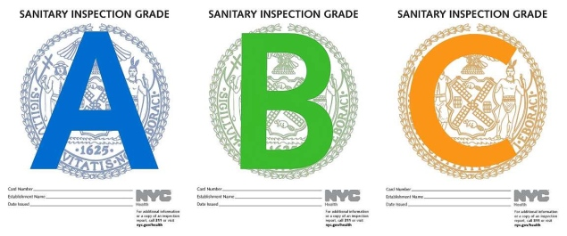
Introduction
NYC is one of the densest city in the world. This city contains a large quantity of restaurant. Therefore, the overall restaurant qualities are vital to the residents. Hence the restaurant grade is a good way to tell customers whether restaurants are good or not. After analyzing the data, give suggestion to restaurants for improving.

Slide 3
Hypotheses
Will different types of cuisines treat different in the inspection? My hypothesis: There exist a relationship between type of cuisine and restaurant overall grade. In other words, I believe that western foods (i.e. American, French) are easier to get better grade than non-western foods (i.e. asian foods for example)
Combine with the yelp’s grading system, will higher yelp star helps the restaurant to get a better restaurant grade?

Slide 4
How it works
Phase 1: The New York City dataset can be download directly online. Yelp scrapes via its API.
Phase 2: Sort the data
Phase 3: Use Chi-square to test whether there exist a relationship between type of cuisine and restaurant overall grade. (Hypothesis 1)
Phase 4: See whether yelp’s star will help the restaurants get better grades. (Hypothesis 2)

Slide 5
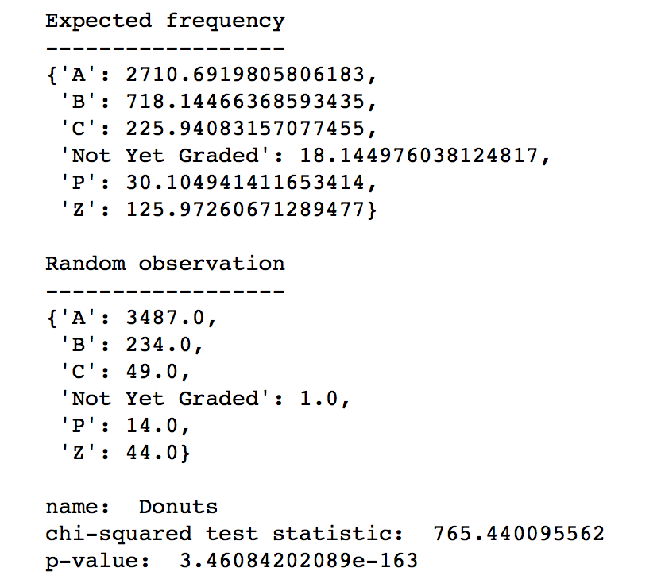
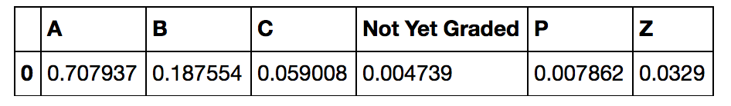
Results for Hypothesis 1

Slide 6
Continuing
Since the p value smaller than 0.01 (99% confidence interval), we can get hypothesis 1 is correct, which means cuisine type has relationship to restaurant grade and looking the graph next page, western foods have advantages to get better grade.

Slide 7
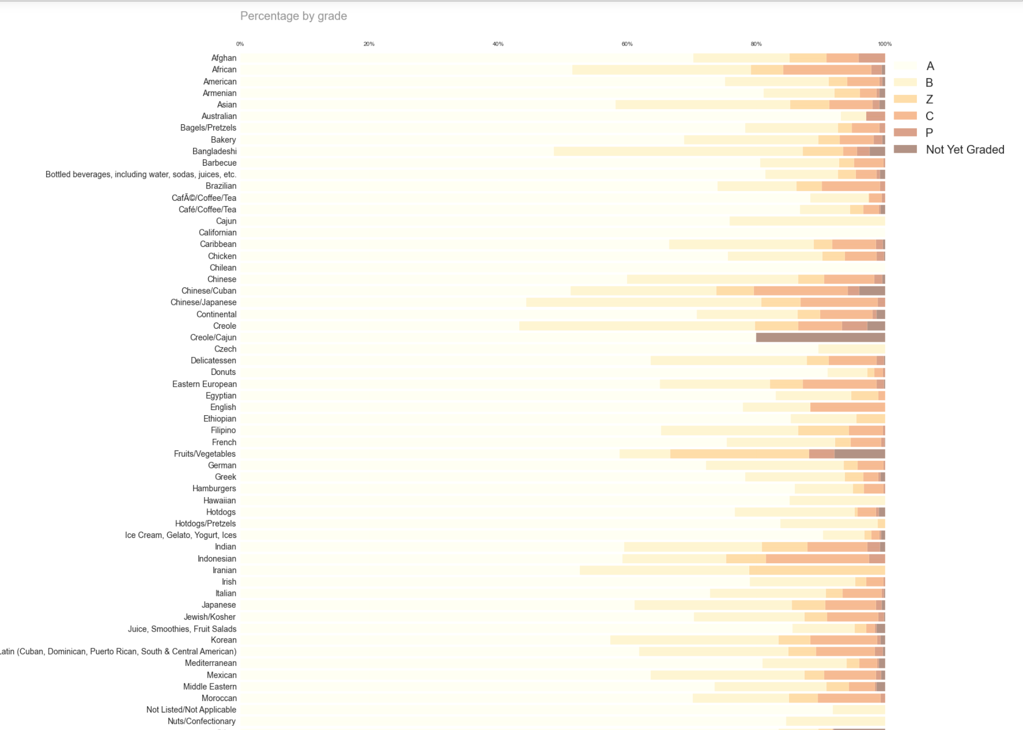
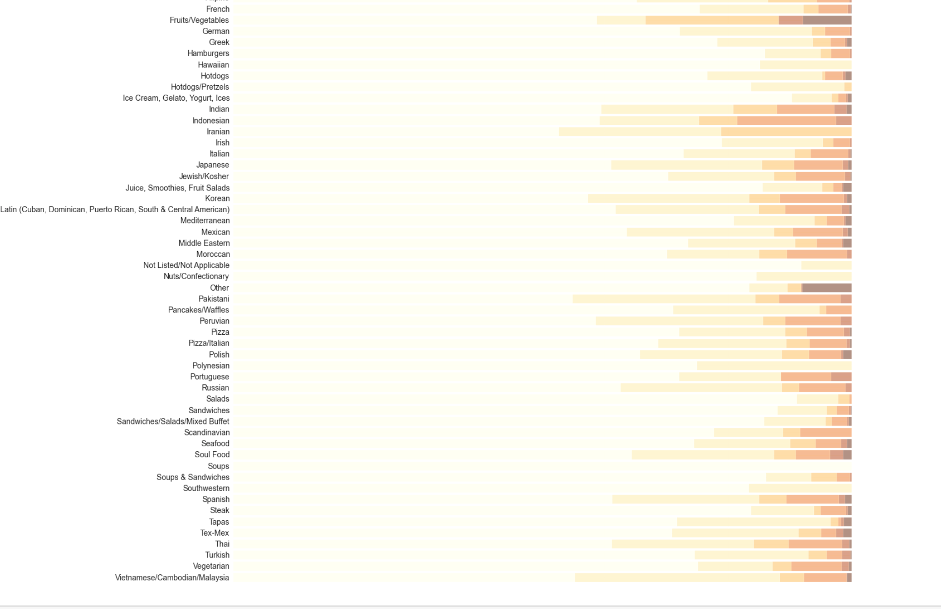
Continuing

Slide 8
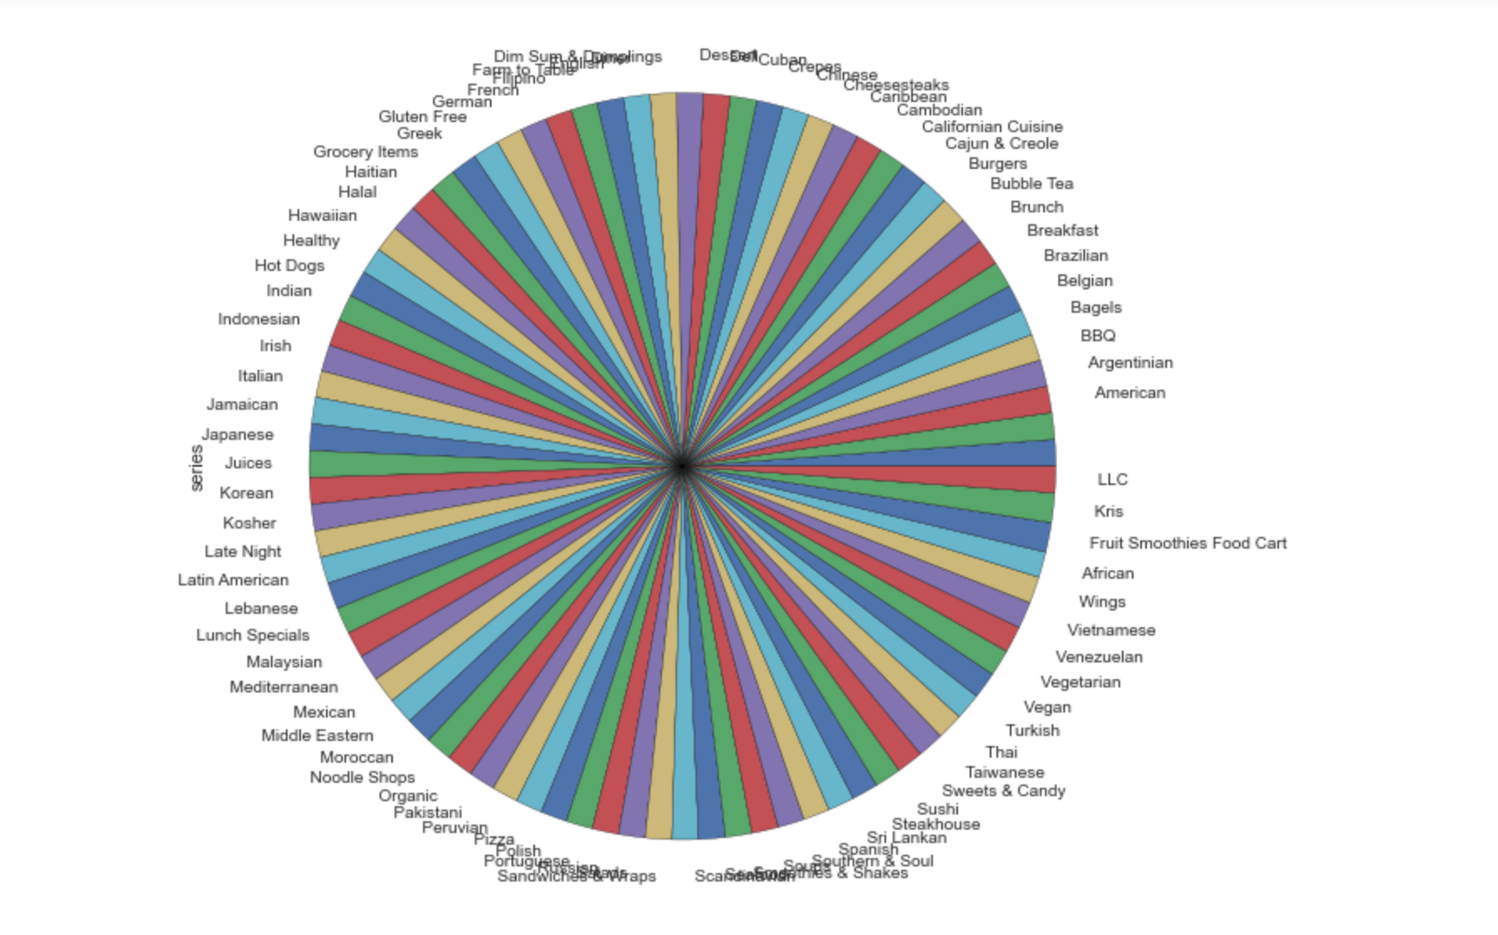
Results for hypothesis 2

Slide 9
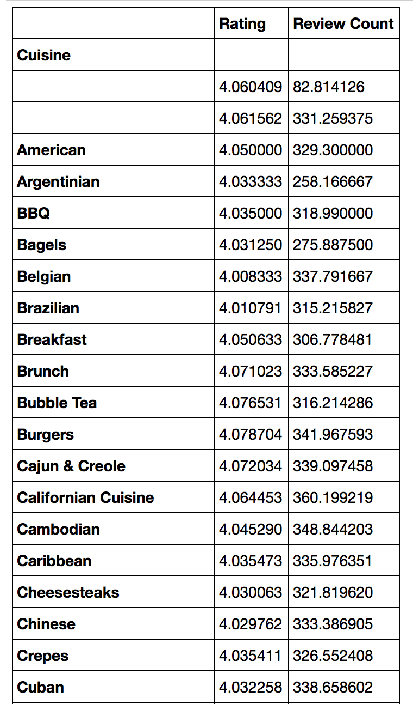
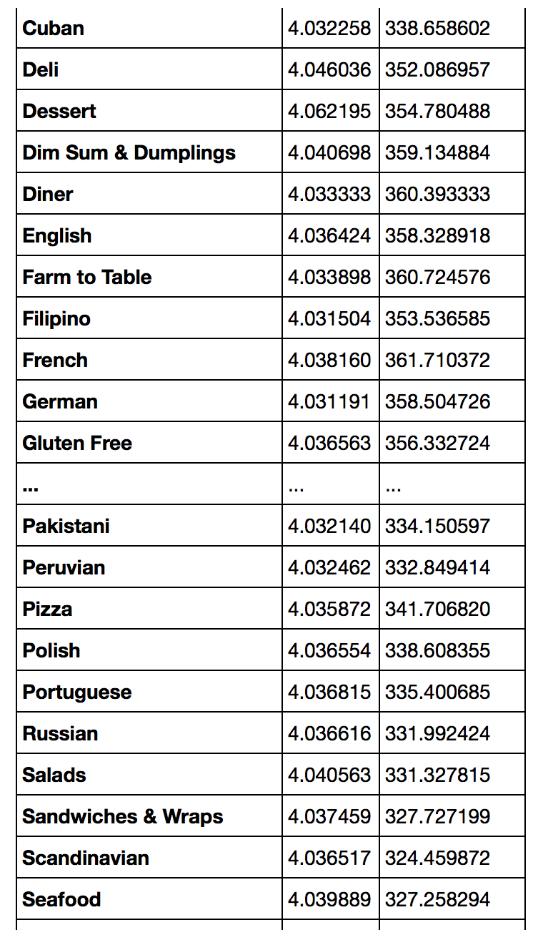
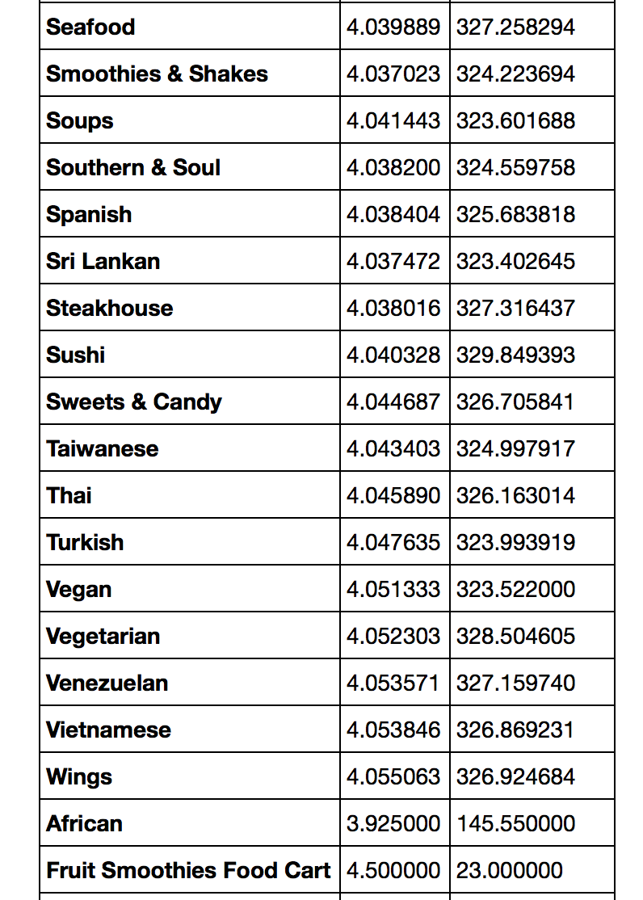
Continuing

Slide 10
Continuing
From the above slide and results from notebook: all cuisines’ star are around 4.0 generally and the numbers are really close. Hence, we can conclude that yelp star does not related to cuisine type. It makes sense since yelp star is based on the taste as the primary factor.

Slide 11
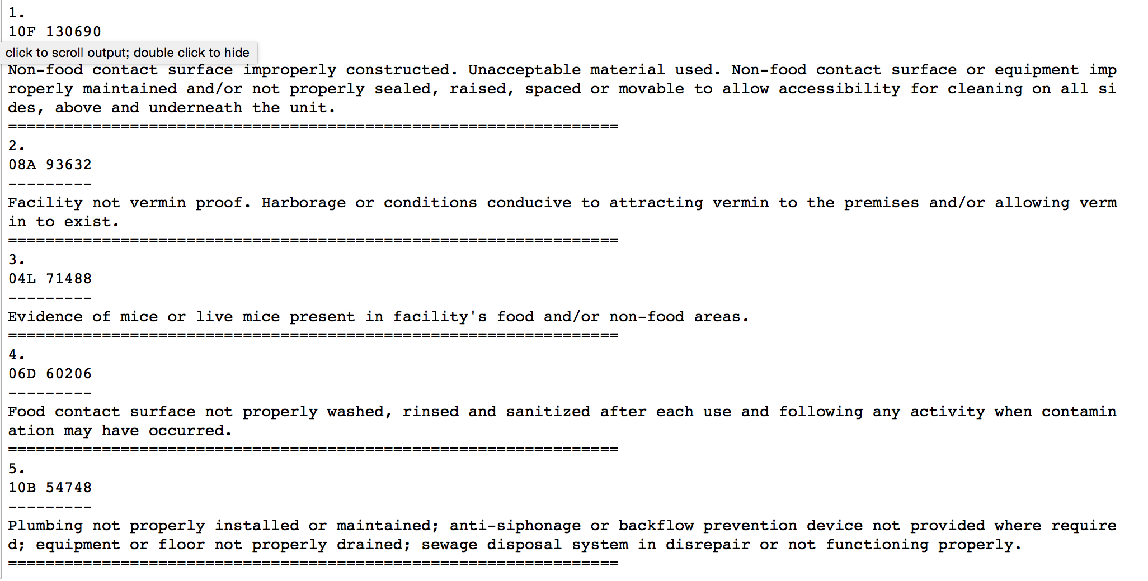
Top Five Violations:

Slide 12
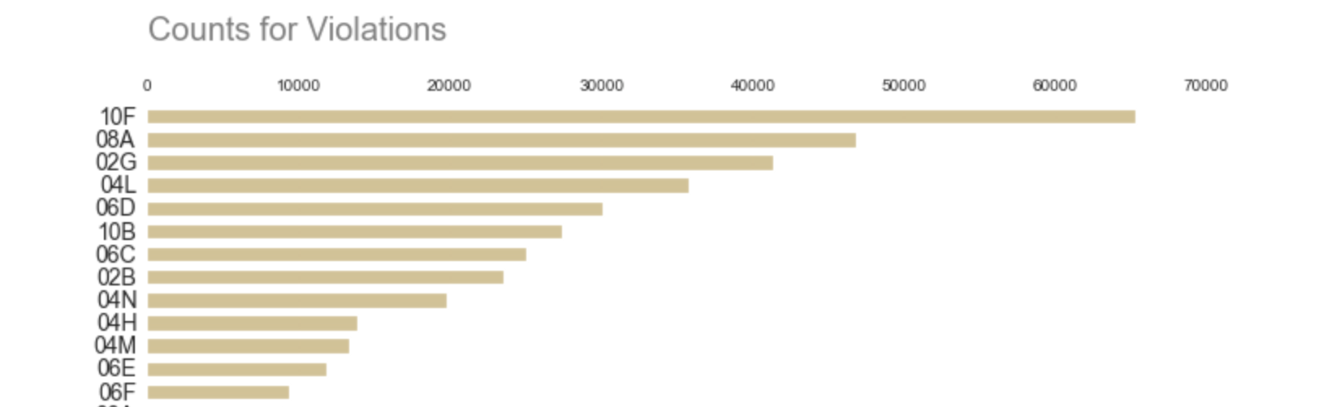
Continuing

Slide 13
Suggestions
Since the cuisine type is related to the grade inspected by city of NYC. Therefore, improving the restaurant environment such as cleanness will help the restaurants get better grade. (Solve the top five violations if they have)
Since the results from yelp’s grade has huge difference with city of NYC. They might discuss together to better help the clients to choose the desired restaurants.

